Slide 1
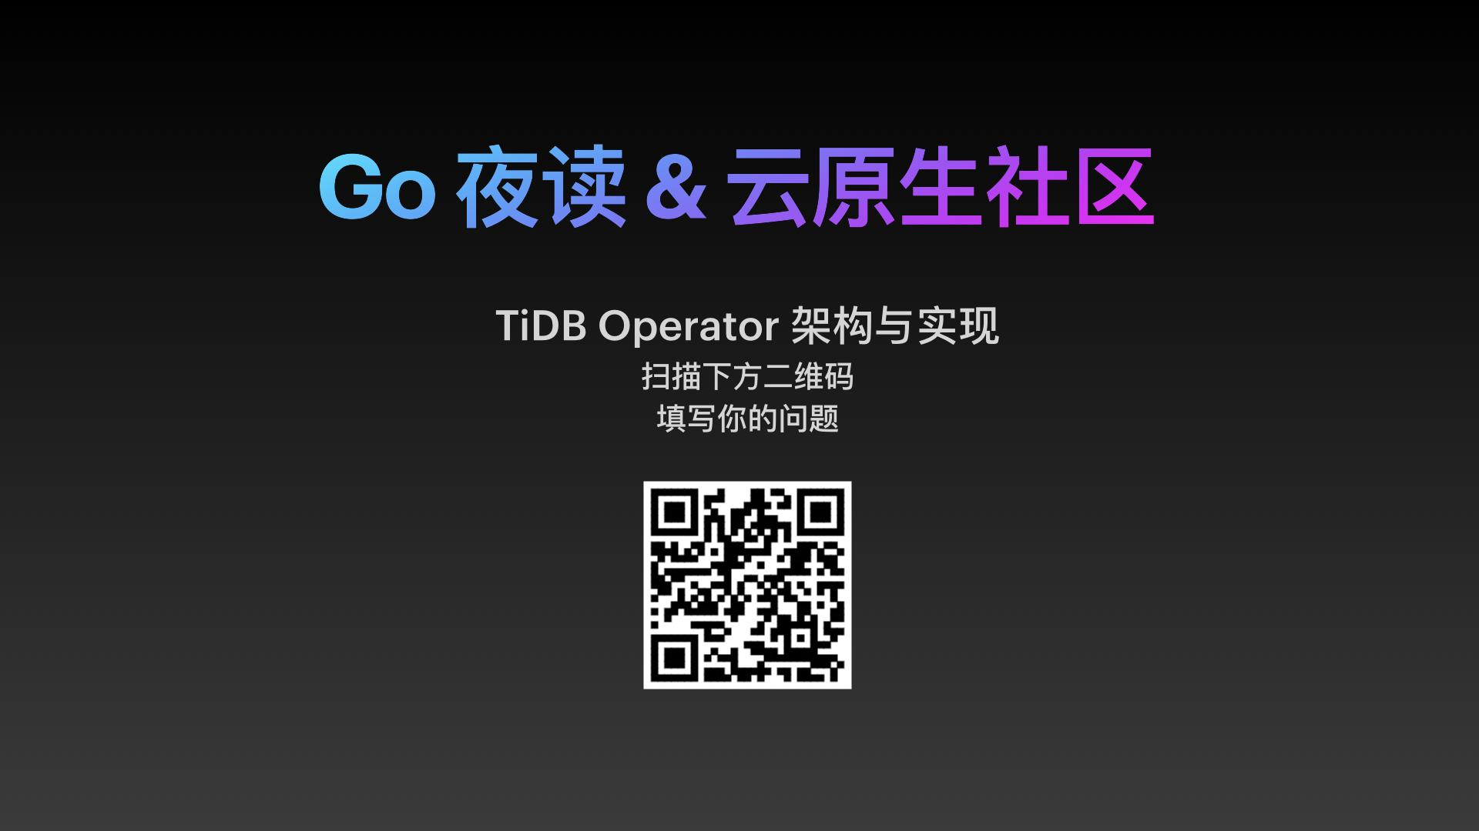

Slide 2


TiDB Operator: Design & Implemention
Presented by Yecheng Fu (@cofyc)

Slide 3
Agenda
TiDB Operator 简介
扩展 Kubernetes 的几种方式
TiDB Operator 实现
Notes:
我先简单介绍下 TiDB Operator ，让大家对其有一个简单概念。然后对 TiDB Operator 中使用的几种常用 Kubernetes 功能扩展方式，做下介绍。最后结合 TiDB Operator 的代码，分析一下 TiDB Operator 的实现细节，如何实现 TiDB 在 Kubernetes 的自动化运维等。

Slide 4
TiDB Operator 是什么

Slide 5








Cloud Native Era: Portable, Scalable, Automated
TiDB
TiDB Operator
Full lifecycle management of TiDB cluster
Deployment
Upgrading
Scaling
Handle network, hardware failures, etc.
Backup/Restore/Data migration
...

Slide 6
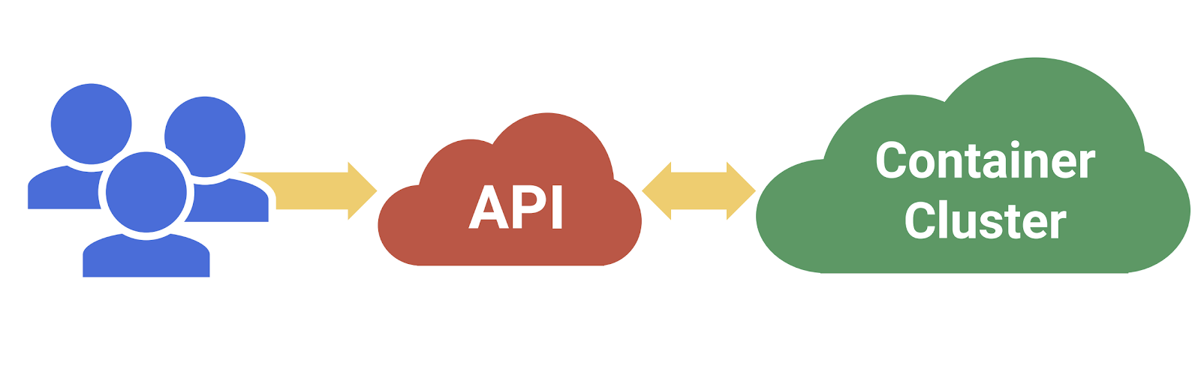
Kubernetes Pattern - Declarative Model
用户描述自己的期望，提交给 Kubernetes API Server
Kubernetes 根据用户的期望以及当前的状态，协调各方达成用户的期望

Slide 7
Kubernetes Pattern - Declarative Model
Kubernetes has pod, deployment, statefulset, etc.
But it does not know how to operate a TiDB cluster...

Slide 8
Kubernetes Pattern - Declarative Model
Kubernetes has pod, deployment, statefulset, etc.
But it does not know how to operate TiDB cluster…
Until we implemented TiDB Operator

Slide 9
Operator Pattern - Extending Kubernetes
TiDB
TiDB Operator
PD API
Kubernetes API

Slide 10
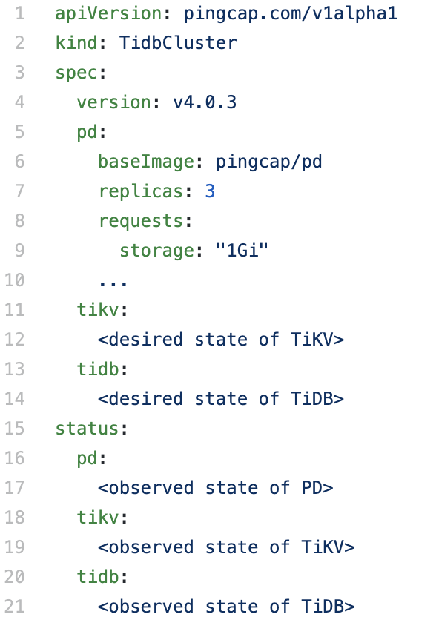
Operator Pattern - Custom Resource & Controller
Desired State
Actual State
Compare & Make Changes

Slide 11
扩展 Kubernetes 的几种方式

Slide 12
Common ways to extend Kubernetes
Custom Resource
TidbCluster
TidbInitializer
TidbMonitor
Backup/Restore
Custom Controller
Scheduler Extender (optional)
Admission Webhook (optional)
…Scheduler framework, Aggregated APIServer

Slide 13
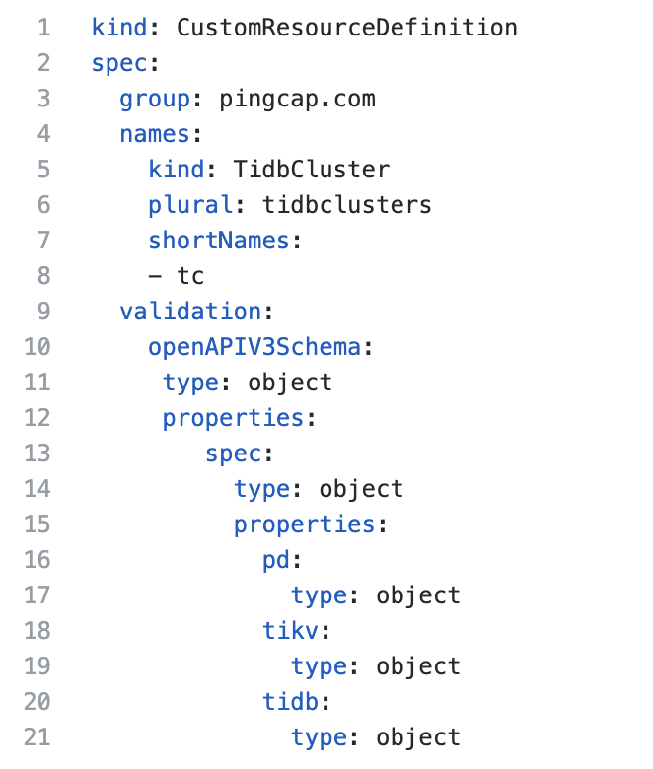
Custom Resource

Slide 14
Custom Controller
TiDB
TiDB Operator
Desired State
Actual State
PD API
Kubernetes API
Compare & Make Changes

Slide 15
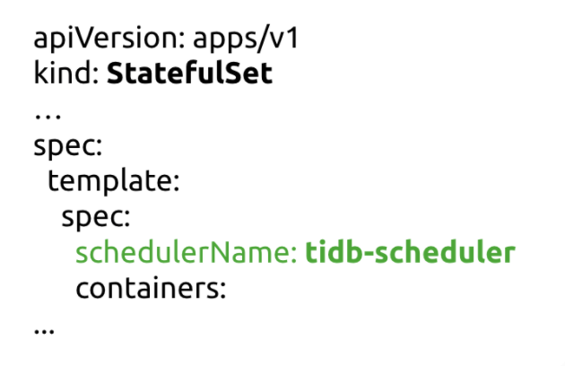
Scheduler Extender
kube-scheduler
kube-scheduler
tidb-scheduler
other Pod
PD Pod
other Pod
TiKV Pod
other Pod
TiDB Pod

Slide 16
Scheduler Extender
3 TiKV ❌
3 TiKV ✅
Node-C
Node-A
Node-B
Node-C
Node-A
Node-B
APP
TiKV
TiKV
TiKV
TiKV
TiKV
APP
TiKV
> 3 TiKV ✅
Node-C
Node-A
Node-B
APP
TiKV
TiKV
TiKV
TiKV
TiKV
* EvenPodsSpread feature introduced in Kubernetes 1.18 provides a more flexible solution

Slide 17
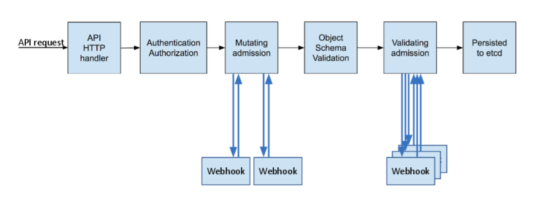
Admission Webhook
Able to intercept API requests and may change or deny it.

Slide 18
TiDB Operator 实现

Slide 19
TiDB Operator Implementation
The tidb-controller-manager
Initialization
Watch objects (Tidb Cluster CR)
Reconcilation
on change of watched CR objects
periodically for TiDB clusters (30s by default)
Full lifecycle management of a TiDB Cluster

Slide 20
tidb-controller-manager - Flowchart
Watch Objects
Start Workers
Initialization
Reconcilation

Slide 21
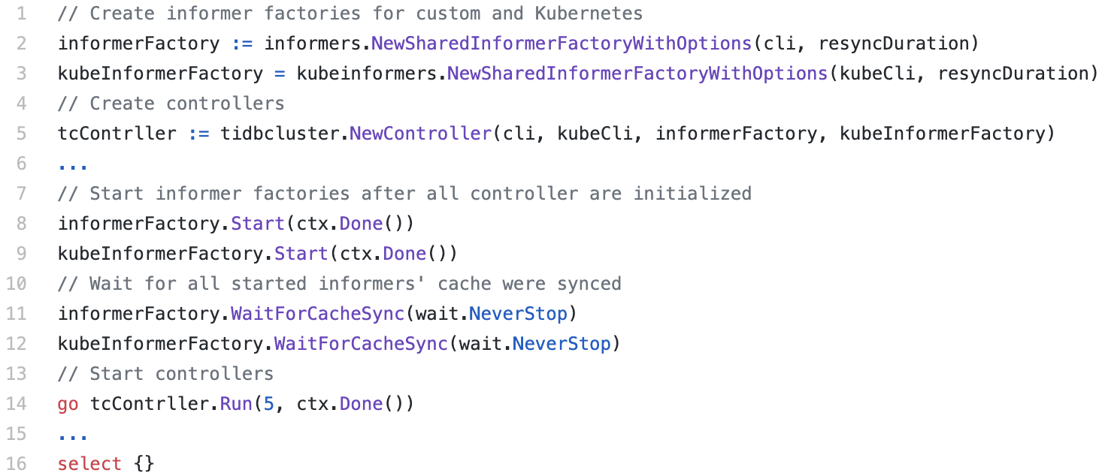
tidb-controller-manager - Initialization

Slide 22
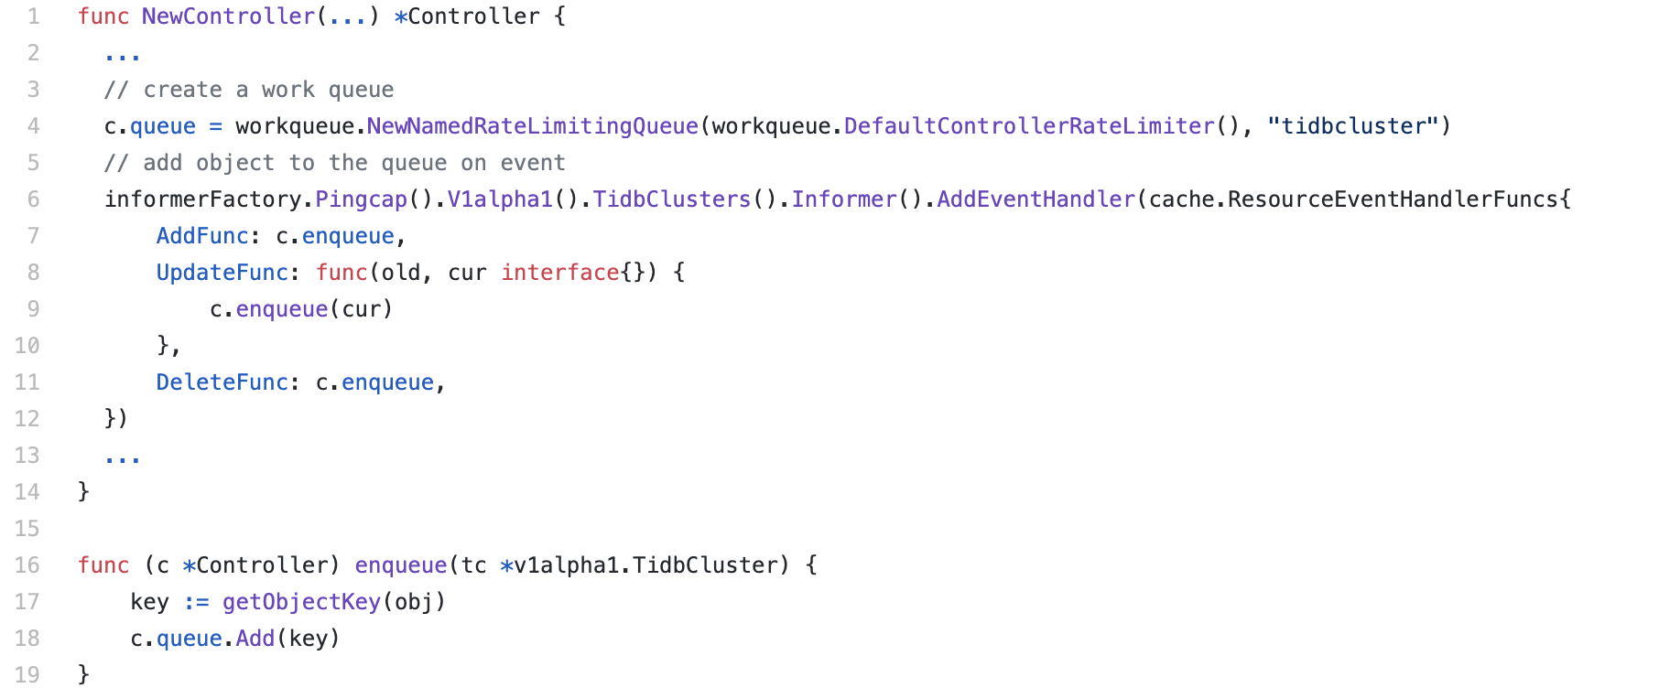
tidb-controller-manager - Watch Objects

Slide 23
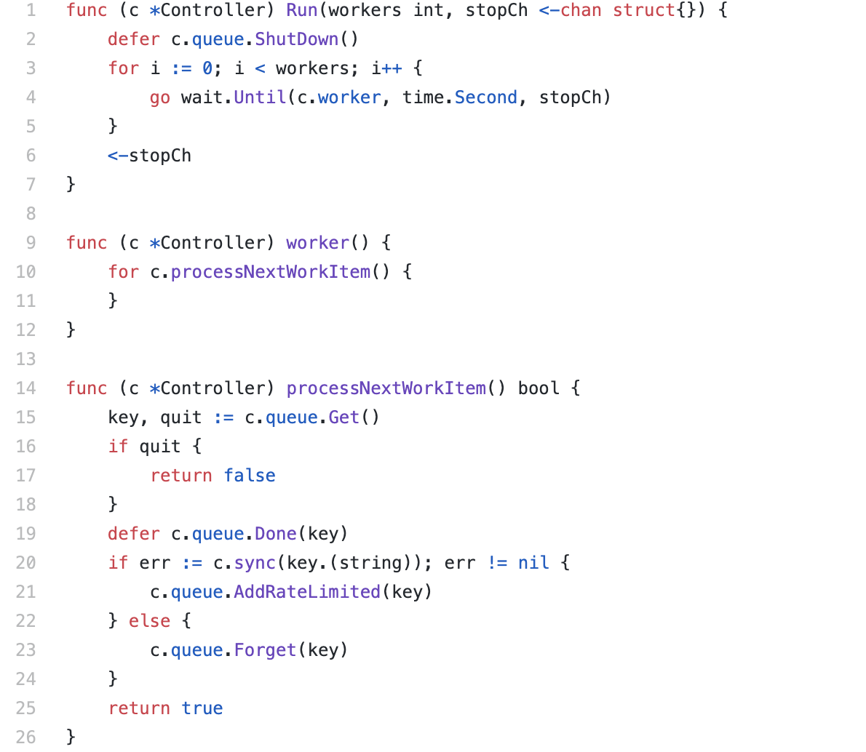
tidb-controller-manager - Start workers

Slide 24
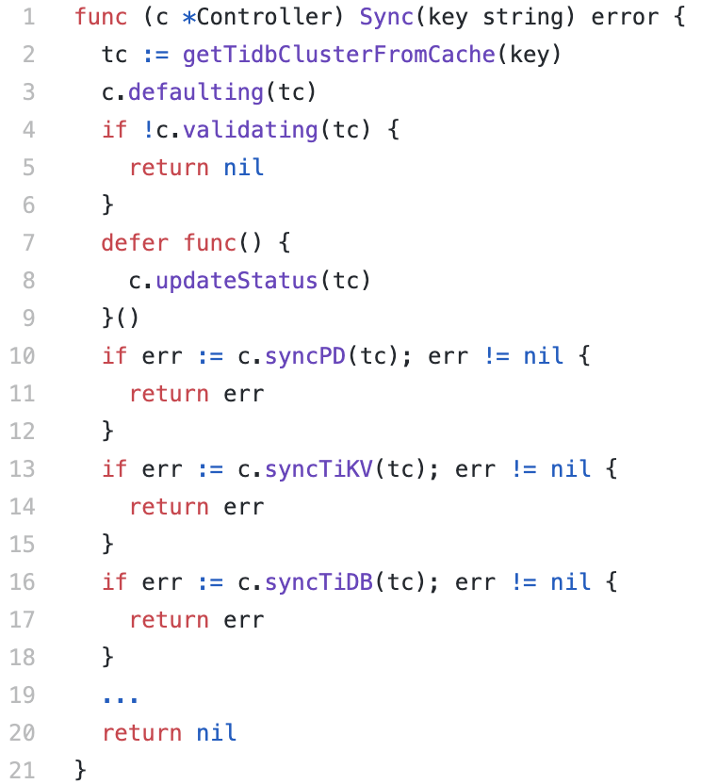
tidb-controller-manager - Reconcliation
Defaulting
Validating
Sync PD
Sync TiKV
Sync TiDB
Sync ...

Slide 25
Full Lifecycle management of a TiDB Cluster
Deploying
Bootstrapping
Configure services/configmaps, etc.
Upgrading
Change version, config, etc.
Scaling
Automatic Failover
Create replacements for failed replicas

Slide 26
Deploying - Bootstrapping
Bootstrap PD cluster with a discovery service
Start TiKV replicas and join the PD cluster
Start TiDB replicas and join the PD Cluster
Create TiDB Service...
PD
PD
PD
TSO/ Metadata
Metadata/ Data location
TiDB
DistSQL API
TiKV
TiKV
TiDB
TiKV
TiKV
KV API
TiDB
TiKV
TiKV
...
...

Slide 27
Deploying - Bootstrapping
TiDB Discovery
PD1
1
PD

Slide 28
Deploying - Bootstrapping
TiDB Discovery
PD1
2
PD2
PD
PD

Slide 29
Deploying - Bootstrapping
TiDB Discovery
PD1
3
PD2
PD
PD3
PD
PD

Slide 30
Deploying - Bootstrapping
TiDB Discovery
TiDB Discovery
PD1
PD1
3
3
PD2
PD2
PD
PD
pd-server --initial=pd3
PD3
PD3
PD
PD
PD
PD

Slide 31
Deploying - Bootstrapping
pd-server --join=pd3,pd2
TiDB Discovery
PD1
3
pd-server --join=pd3
PD2
PD
pd-server --initial=pd3
PD3
PD
PD

Slide 32
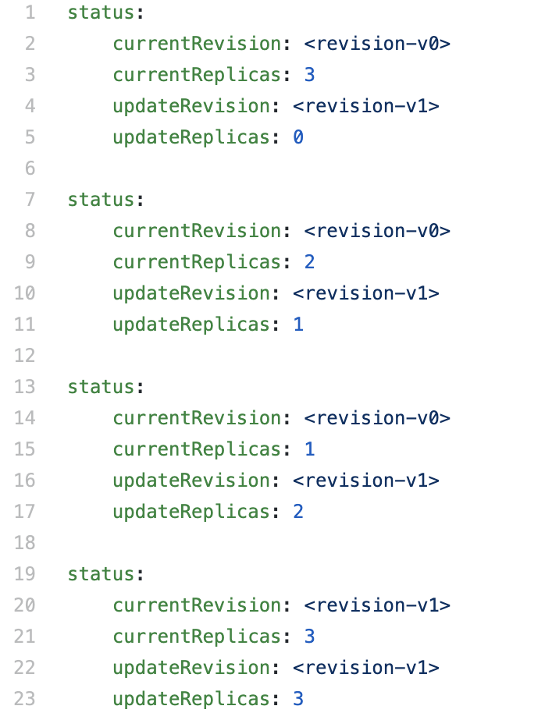
Upgrading
It’s ok to upgrade a High Availability system like TiDB directly.
But, to avoid spikes we use StatefulSet partition to perform a phased roll out.
Upgrade PD
Upgrade TiKV
Upgrade TiDB

Slide 33
Upgrading - PD
For each PD replica
If it’s the leader of PD cluster, transfer the leadership
Upgrade
PD V0
PD V0 (leader)
PD V0
PD V1
PD V0 (leader)
PD V0
PD V1
(leader)
PD V0
PD V0
PD V1
(leader)
PD V1
PD V0
PD V1
(leader)
PD V1
PD V1

Slide 34
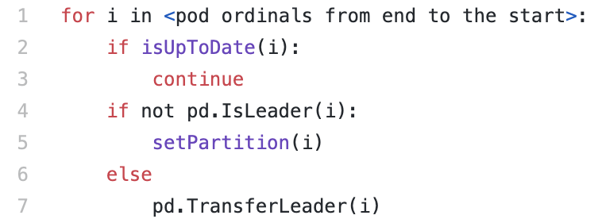
Upgrading - PD
For each PD replica
If it’s the leader of PD cluster, transfer the leadership
Upgrade

Slide 35
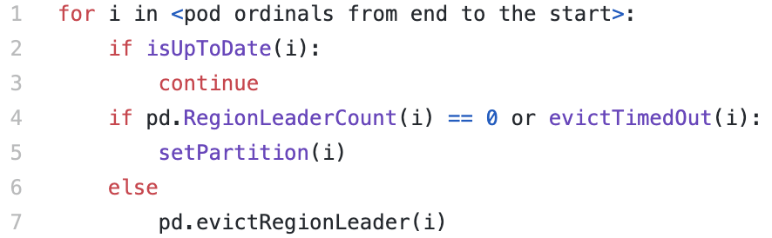
Upgrading - TiKV
For each TiKV replica
Evict region leaders
Wait for all region leaders are evicted or the timeout expired
Upgrade

Slide 36
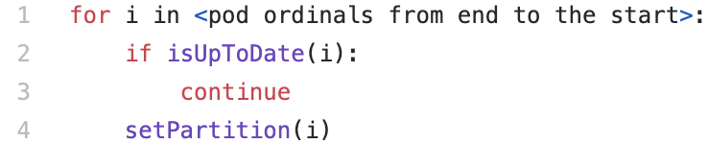
Upgrading - TiDB
For each TiDB replica
Upgrade

Slide 37
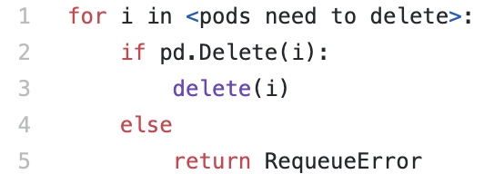
Scaling In - PD
Delete the member via PD API first
After the member is deleted successfully, scale in the StatefulSet

Slide 38
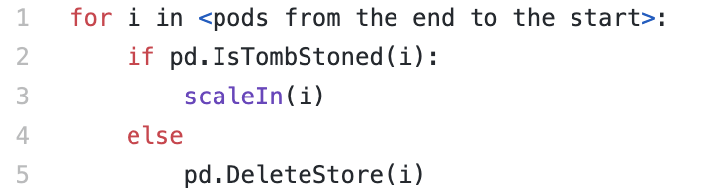
Scaling In - TiKV
Delete the TiKV store via PD API first
Wait for the store to be tombstoned
Scale the statefulset

Slide 39
Scaling In - TiDB
Scale the statefulset directly

Slide 40
Scaling Out
Clean retained PVCs if necessary
Scale the statefulset
Wait for new replicas to join the cluster

Slide 41
Automatic Failover
3 default replicas in each raft group can tolerate one member failure
Node A
Node B
Node C
TiKV-0
TiKV-1
TiKV-2

Slide 42
Automatic Failover
What if a repliac is down for a long time
It’s dangerous!
What can we do?
Node A
Node B
Node C
TiKV-0
TiKV-1
TiKV-2

Slide 43
Automatic Failover
Node A
Node B
Node C
Node D
TiKV-0
TiKV-1
TiKV-2
TiKV-3

Slide 44
Automatic Failover
Node A
Node B
Node C
Node D
TiKV-0
TiKV-1
TiKV-2
TiKV-3

Slide 45
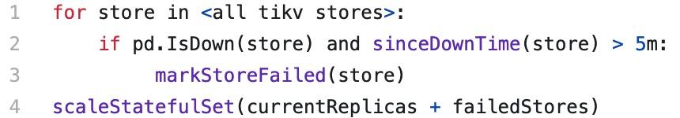
Automatic Failover
A store is marked Down by PD when it’s unreachable for 30m (by default)
A store is marked Failed by TiDB Operator when it’s Down for 5m (by default)
The controller will increase the replicas by the number of failed replicas

Slide 46
Summary
TiDB Operator 简介
Cloud Native Era: Full Automation
Kubernetes Pattern: Declarative Model
Operator Pattern: Extending Kubernetes
扩展 Kubernetes 的几种方式
Custom Resource
Custom Controller
Scheduler Extender
Admission Webhook
TiDB Operator 实现
the tidb-controller-manager
Full lifecycle management of a TiDB Cluster
Deploying, Upgrading, Scaling, Automatic Failover, etc.

Slide 47



Thank You!
https://github.com/pingcap/tidb-operator
Presented by Yecheng Fu (@cofyc)

